Slide 1


EXPLORATORY DATA ANALYSIS ON LIFE EXPECTANCY
A PRESENTATION BY GROUP-B2

Slide 2
GROUP MEMBERS AND OUTLINE Supervisor: Samuel Kwame Dassi
GROUP MEMBERS
Solomon Arko-Aidoo
Philomena Amoesi
Seth Kwame Dassi
Corban Enam Bubutor
Caroline Arthur

Slide 3
OUTLINE
Tools and Libraries
A brief notes about the dataset
Questions
Visualizations and insights about the analysis
Conclusions

Slide 4
TOOLS AND LIBRARIES
Python: JupyterNotebook
LIBARY
PANDAS
NUMPY
MATPLOTLAB
SEABORN

Slide 5
INFORMATION ABOUT THE DATASET
Life expectancy refers to the statistical measure of the average time a person is expected to live, based on some factors such as health, GDP, Population etc. (WHO,2020)

Slide 6
The dataset is made up of 2938 rows and 22 columns.
Some of the column names are,
Country, Status, Year, Life Expectancy, Population, Adult mortality, under five deaths, HIV AIDS, hepatitis B, among others.
The data was cleaned by dropping empty cells, replacing some empty cells and removing some uncompleted entries.

Slide 7
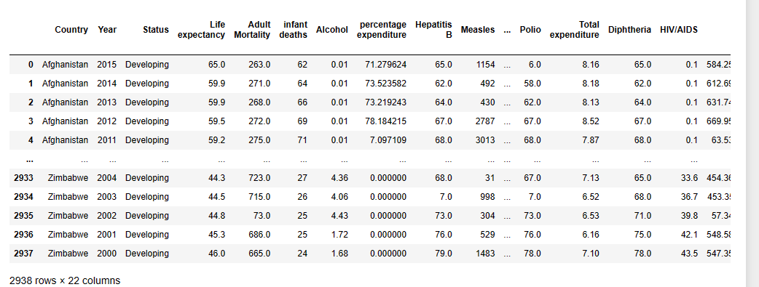
NATURE OF THE DATASET

Slide 8
QUESTIONS
1. Which country has the highest life expectancy rate and GDP?
2. Which country has the lowest life expectancy rate and GDP?
3. Which country has the highest under five deaths
4. What is the highest Adult mortality?
5. Which Country records the highest polio and HIV/AIDS
6. Which Country consumes more alcohol?
7. Has Total income any effect on life expectancy?
8. Is there any relationship between Adults mortality and HIV/AIDS?
9. Is there any relationship between infant deaths and Polio?

Slide 9

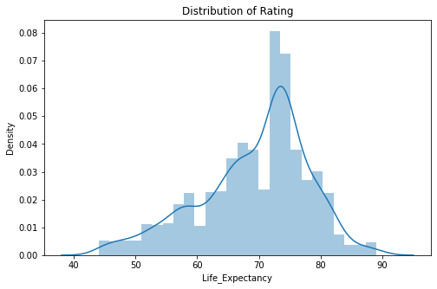
DISTRIBUTION OF LIFE EXPECTANCIES
The life expectancy of the countries is positively skewed between the ages of 45 and 89 with 75 been the highest life expectancy of the countries.

Slide 10
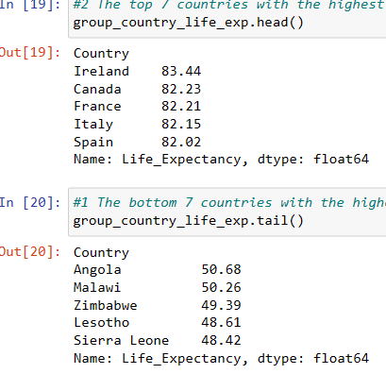
COUNTRIES WITH THE HIGHEST AND LOWEST LIFE EXPECTANCIES

Slide 11
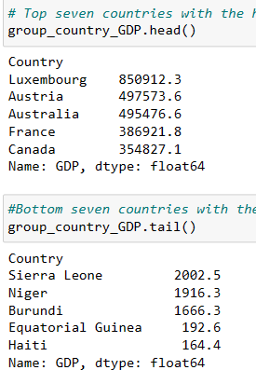
HIGHEST AND LOWEST TOTAL GDP OF COUNTRIES
The highest GDP was recorded by Luxembourg and the lowest was Haiti.
While the highest GDP countries are from Europe, most African countries recorded the lowest GDP

Slide 12
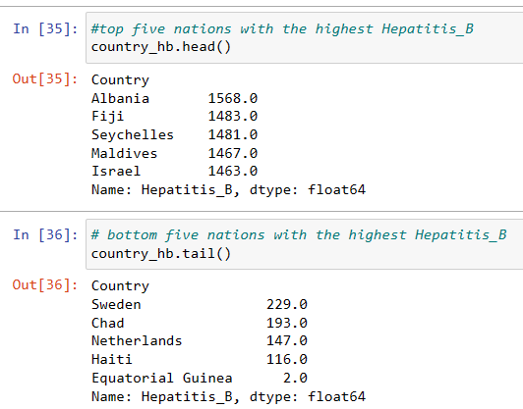
TOP AND BOTTOM FIVE HEPATITIS B RECORDING COUNTRIES

Slide 13
NOTE ON HEPATITIS B RECORDING
From the previous slide, it was noted that Albania recorded the highest number of hepatitis B with 1568 cases
While Equatorial Guinea recorded the lowest number with just 2 cases over the years

Slide 14
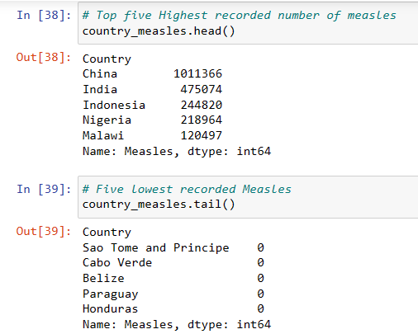
REPORT ON NUMBER OF MEASLES CASES RECORDED

Slide 15
China leads in the number of measle cases recorded over the years with about 1011366 cases recorded averagely, followed by India with about 475074 cases.
Paraguay and Honduras in other hand, recorded zero cases of measle over the years.

Slide 16
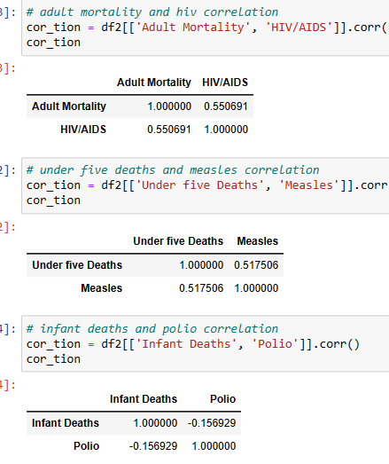
RELATIONSHIPS BETWEEN SOME OF THE VARIABLES IN THE DATASET

Slide 17
RELATIONSHIPS BETWEEN SOME OF THE VARIABLES IN THE DATASET
There is a moderate positive relationship of 0.551 between adult mortality and HIV/AIDS.
Also, under five deaths and measle has a strong moderate positive relationship of coefficient of 0.518.
On the other hand, infant deaths and polio has a weak negative relationship of -0.157.

Slide 18

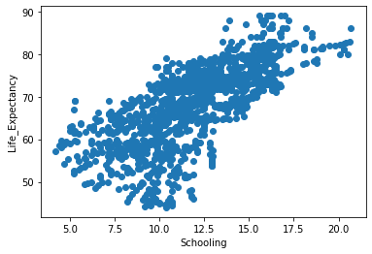
SCATTER DIAGRAM SHOWING THE CAUSATION OF SCHOOLING
From the diagram, this can be observed that there is a positive correlation between Schooling and Life Expectancy.

Slide 19
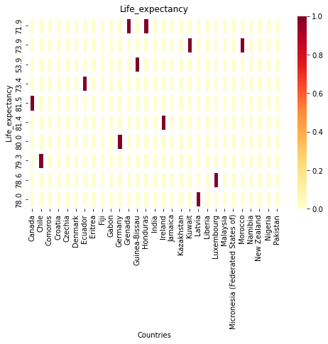
LIFE EXPECTANCY CONCENTRATIONS IN COUNTRIES
From the diagram below, most life expectancy ratios are in Honduras and Grenada

Slide 20
INSIGHTS FROM THE OBSERVATION
A lot of variables(that is; Economic factors, Social factors, and Health factors) went into the data, however some insights waved across this observation are;
The observatory analysis depicts a correlation(positive relationship) between the GDP and Life Expectancy. Therefore, if countries decide to centralize focus adequately to increasing the GDP of their respective countries through economic activities, it has the tendency of rising the rate of Life Expectancy considering other factors constant.
Most Countries with mass number of population have typically the least Life expectancy concentration analysis compared to those with smaller populations like Grenada and Honduras. Therefore, conscious investment in labor forces could be triggered to these countries with lesser population but encouraging Life expectancy.

Slide 21
CONCLUSION
From the Analysis and Visualization done, we observed there is massive relationship between the Life Expectancies and the Economic, Social and Health variables
There are other factors that may contribute to either the rise or fall in the number of Life Expectancies
Social like Schooling
Economic like the GDP
Health issues like HIV/AIDS, Measle, Polio among others

